Slide 1
Module - 2
Dimension Reduction

Slide 2
Dimension Reduction - Introduction
The dimension of a dataset, which is the number of variables, must be reduced for the data mining algorithms to operate efficiently.
This process is part of the pilot/prototype phase of data mining and is done before deploying a model.
The dimensionality of a model is the number of predictors or input variables used by the model.

Slide 3
Several dimension reduction approaches:
(1)Incorporating domain knowledge to remove or combine categories,
(2)Using data summaries to detect information overlap between variables (and remove or combine redundant variables or categories),
(3)Using data conversion techniques such as converting categorical variables into numerical variables, and
(4)Employing automated reduction techniques, such as principal components analysis (PCA), where a new set of variables (which are weighted averages of the original variables) is created.
These new variables are uncorrelated and a small subset of them usually contains most of their combined information (hence, we can reduce dimension by using only a subset of the new variables).

Slide 4
In data mining, sometimes we encounter problem where there is a large number of variables in the database.
Even when the initial number of variables is small, this set quickly expands in the data preparation step, where new derived variables are created (e.g., dummies for categorical variables and new forms of existing variables).
A large number of variables also poses computational problems for some supervised as well as unsupervised algorithms.

Slide 5
Although data mining prefers automated methods over domain knowledge, it is important at the first step of data exploration to make sure that the variables measured are reasonable for the task at hand. The integration of expert knowledge through a discussion with the data provider (or user) will probably lead to better results.
Practical considerations include:
Which variables are most important for the task at hand, and which are most likely to be useless?
Which variables are likely to contain much error?
Which variables can actually be measured before the outcome occurs?

Slide 6
Types of Data Sets
Record
Relational records
Data matrix, e.g., numerical matrix, crosstabs
Document data: text documents:
Transaction data
Graph and network
World Wide Web
Social or information networks
Molecular Structures
Ordered
Video data: sequence of images
Temporal data: time-series
Sequential Data: transaction sequences
Genetic sequence data
Spatial, image and multimedia:
Spatial data: maps
Image data:
Video data:
Notes:
May we categorize data along the following dimensions?
- structured, semi-structured, and unstructured
- numeric and categorical
- static and dynamic (temporal?)
- by application

Slide 7
Attributes
Attribute (or dimensions, features, variables): a data field, representing a characteristic or feature of a data object.
E.g., customer _ID, name, address
Types:
Nominal
Binary
Numeric: quantitative
Interval-scaled
Ratio-scaled

Slide 8

Categorical Attribute Types
Nominal: Limited number of different values or list of possible values that the variable may take. For example a variable Industry takes values such as financial, engineering, retail etc.,
Hair_color = {auburn, black, blond, brown, grey, red, white}
marital status, occupation, ID numbers, zip codes
Binary
Nominal attribute with only 2 states (0 and 1)
Symmetric binary: both outcomes equally important
e.g., gender
Asymmetric binary: outcomes not equally important.
e.g., medical test (positive vs. negative)
Convention: assign 1 to most important outcome (e.g., disease)
Ordinal
Values have a meaningful order (ranking) but magnitude between successive values is not known.
Size = {small, medium, large}, grades, army rankings.

Slide 9
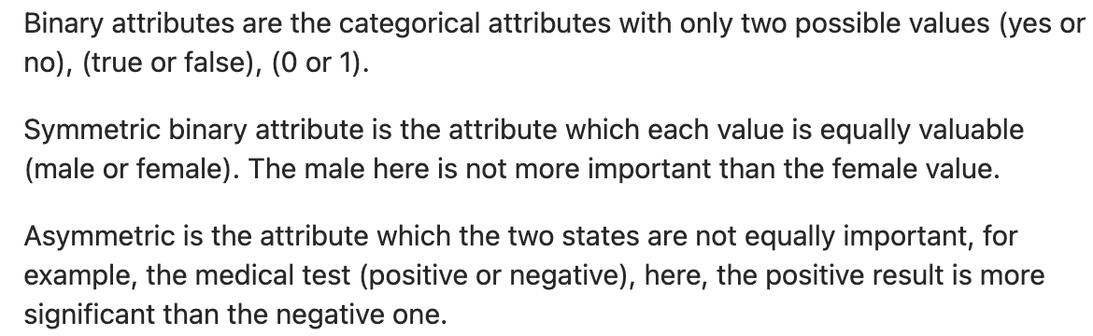

Slide 10
Numeric Attribute Types
Quantity (integer or real-valued)
Interval
Scales that describe values where the interval between the values has meaning. For example when looking at three data points measured on the Fahrenheit scale, 5⁰F, 10⁰F, 15⁰F, the differences between the values from 5 to 10 and from 10 to 15 are both 5 and a difference of 5⁰F in both cases has the same meaning. Since 10⁰F is not twice as hot as 5⁰F. Interval scales do not have a natural zero.
Ratio
A ratio scale of bank account balance whose possible values are $5, $10 and $15. The difference between each pair is $5 and $10 is twice as much as $5. Since ratios of values are possible they are defined as having a natural zero.

Slide 11
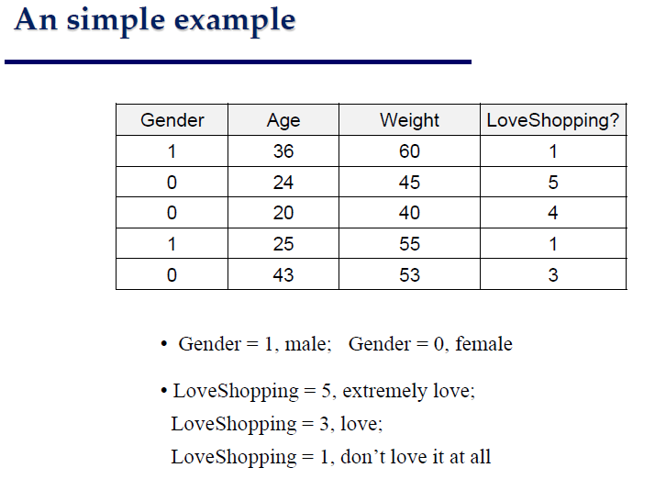

Slide 12
Why Data Preprocessing?
Data in the real world is dirty
incomplete: missing attribute values, lack of certain attributes of interest, or containing only aggregate data
e.g., occupation=“”
noisy: containing errors or outliers
e.g., Salary=“-10”
inconsistent: containing discrepancies in codes or names
e.g., Age=“42” Birthday=“03/07/1997”
e.g., Was rating “1,2,3”, now rating “A, B, C”
e.g., discrepancy between duplicate records

Slide 13
Why Is Data Preprocessing Important?
No quality data, no quality mining results!
Quality decisions must be based on quality data
e.g., duplicate or missing data may cause incorrect or even misleading statistics.
Data preparation, cleaning, and transformation comprises the majority of the work in a data mining application (90%).

Slide 14
Major Tasks in Data Preprocessing
Data cleaning
Fill in missing values, smooth noisy data, identify or remove outliers and noisy data, and resolve inconsistencies
Data integration
Integration of multiple databases, or files
Data transformation
Normalization and aggregation
Data reduction
Obtains reduced representation in volume but produces the same or similar analytical results
Data discretization (for numerical data)

Slide 15
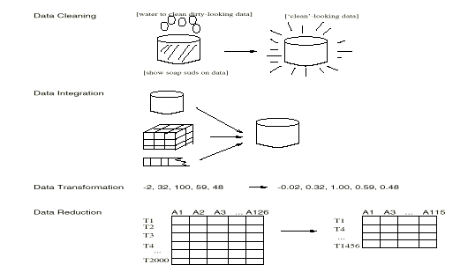
Forms of Data Preprocessing

Slide 16
Data Cleaning
Importance
“Data cleaning is one of the three biggest problems in data warehousing”—Ralph Kimball
“Data cleaning is the number one problem in data warehousing”—DCI survey
Data cleaning tasks
Fill in missing values
Identify outliers and smooth out noisy data
Correct inconsistent data
Resolve redundancy caused by data integration

Slide 17
Missing Data
Data is not always available
E.g., many tuples have no recorded value for several attributes, such as customer income in sales data
Missing data may be due to
equipment malfunction
inconsistent with other recorded data and thus deleted
data not entered due to misunderstanding
certain data may not be considered important at the time of entry
not register history or changes of the data
Missing data may need to be inferred.

Slide 18
How to Handle Missing Data?
Ignore the tuple: usually done when class label is missing (assuming the tasks in classification—not effective when the percentage of missing values per attribute varies considerably.
Fill in the missing value manually: tedious + infeasible?
Fill in it automatically with
a global constant : e.g., “unknown”, a new class?!
the attribute mean
the attribute mean for all samples belonging to the same class: smarter
the most probable value: inference-based such as Bayesian formula or decision tree

Slide 19
Noisy Data
Noise: random error or variance in a measured variable
Incorrect attribute values may due to
faulty data collection instruments
data entry problems
data transmission problems
technology limitation
inconsistency in naming convention
Other data problems which requires data cleaning
duplicate records
incomplete data
inconsistent data

Slide 20
How to Handle Noisy Data?
Binning
first sort data and partition into (equal-frequency) bins
then one can smooth by bin means, smooth by bin median, smooth by bin boundaries, etc.
Regression
smooth by fitting the data into regression functions
Clustering
detect and remove outliers
Combined computer and human inspection
detect suspicious values and check by human (e.g., deal with possible outliers)

Slide 21
Binning Methods for Data Smoothing
Sorted data for price (in dollars): 4, 8, 9, 15, 21, 21, 24, 25, 26, 28, 29, 34.
Initial data must be sorted.
* Partition into equal-frequency (equi-depth) bins:
- Bin 1: 4, 8, 9, 15
- Bin 2: 21, 21, 24, 25
- Bin 3: 26, 28, 29, 34
* Smoothing by bin means:
- Bin 1: 9, 9, 9, 9
- Bin 2: 23, 23, 23, 23
- Bin 3: 29, 29, 29, 29
* Smoothing by bin boundaries:
- Bin 1: 4, 4, 4, 15
- Bin 2: 21, 21, 25, 25
- Bin 3: 26, 26, 26, 34

Slide 22
Data Smoothening by Three Point Summary
For any Instance ‘I’, the formula for three point moving average is calculated as follows :
= X_{I-1} + X_{I} + X_{I+1} / 3
Consider the following data set : 3,4,7,2,14,0,21,9,1,5
The data set would be changed as 3, 4.67,4.33,7.67,5.33,11.67,10,10.33,5,5

Slide 23
Try it out

Slide 24









Slide 25
Data Summaries
Data visualization, an important initial step of data exploration is getting familiar with the data and their characteristics through summaries and graphs.
The better you understand the data, the better the results from the modeling or mining process.
Numerical summaries and graphs of the data are very helpful for data reduction.
The information that they convey can assist in combining categories of
a categorical variable, in choosing variables to remove, in assessing the level of information overlap between variables, and more.

Slide 26
The mean, standard deviation, min, max, median, range and length are very helpful for learning about the characteristics of each variable.
1) They give us information about the scale and type of values that the variable takes.
2) The min and max functions can be used to detect extreme values that might be errors.
3) The mean and median give a sense of the central values of that variable.
4) The range and standard deviation give a sense of how dispersed the data are (relative to the mean). Further options, such as sum(is.na(variable)), which gives the number of null values, can tell us about missing values.

Slide 27
Mean
The mean of a set of data is the sum of the data values divided by the number of values.
Problem 1:
Marci’s exam scores for her last math class were 79, 86, 82, and 94. What would the mean of these values would be?
Answer:
(79+86+82+94) / 4 → 85.25 Typically we round means to one more decimal place than the original data had. In this case, we would round 85.25 to 85.3

Slide 28
Median
The median of a set of data is the value in the middle when the data is in order.
To find the median, begin by listing the data in order from smallest to largest, or largest to smallest.
If the number of data values, N is odd, then the median is the middle data value. This value can be found by rounding N/2 up to the next whole number.
If the number of data values is even, there is no one middle value, so we find the mean of the two middle values. (values N/2 and N/2 + 1)

Slide 29
Median Problem 1
Find the median of these quiz scores: 5 10 8 6 4 8 2 5 7 7
Answer:
Sorting the quiz scores: 2 4 5 5 6 7 7 8 8 10
Since there are 10 data values, an even number, there is no one middle number. So we find the mean of the two middle numbers, 6 and 7, and get (6+7)/2 = 6.5.
The median quiz score is 6.5.

Slide 30
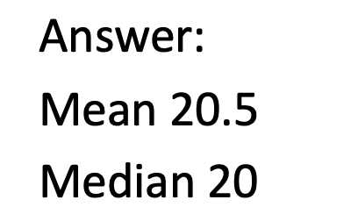

Mean and Median Problem
The number of touchdown (TD) passes thrown by each of the 31 teams in the National Football League in the 2000 season are shown below.
37 33 33 32 29 28 28 23 22 22 22 21 21 21 20 20 19 19 18 18 18 18 16 15 14 14 14 12 12 9 6
What is the mean and median of TD passes?

Slide 31
Mode
The mode is the element of the data set that occurs most frequently.
The mode is fairly useless with data like weights or heights where there are a large number of possible values.
The mode is most commonly used for categorical data, for which median and mean cannot be computed.

Slide 32
Vehicle color survey data is provided here. Which color is the mode?
Color | Frequency
Blue | 3
Green | 5
Red | 4
White | 3
Black | 2
Grey | 3
It is possible for a data set to have more than one mode if several categories have the same frequency, or no modes if each every category occurs only once.

Slide 33
Measure of Variance
Consider these three sets of quiz scores:
Section A: 5 5 5 5 5 5 5 5 5 5
Section B: 0 0 0 0 0 10 10 10 10 10
Section C: 4 4 4 5 5 5 5 6 6 6
All three of these sets of data have a mean of 5 and median of 5, yet the sets of scores are clearly quite different. In section-A, everyone had the same score; in section-B half the class got no points and the other half got a perfect score, assuming this was a 10-point quiz. section-C was not as consistent as section A, but not as widely varied as section B.
In addition to the mean and median, which are measures of the “typical” or “middle” value, we also need a measure of how “spread out” or varied each data set is.

Slide 34
Range
The range = Maximum value – Minimum Value.

Slide 35
Using the quiz scores,
For section A, the range is 0 since both maximum and minimum are 5 and 5 – 5 = 0
For section B, the range is 10 since 10 – 0 = 10
For section C, the range is 2 since 6 – 4 = 2
In the last example, the range seems to be revealing how spread out the data is. However, suppose we add a fourth section, Section D, with scores 0 5 5 5 5 5 5 5 5 10.
This section also has a mean and median of 5. The range is 10, yet this data set is quite different than Section B. To better illuminate the differences, we’ll have to turn to more sophisticated measures of variation.

Slide 36
Standard deviation
The standard deviation is a measure of variation based on measuring how far each data value deviates, or is different, from the mean. A few important characteristics:
Standard deviation is always positive.
Standard deviation will be zero if all the data values are equal, and will get larger as the data spreads out.
Standard deviation has the same units as the original data.

Slide 37
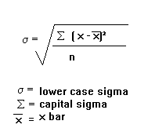
To compute standard deviation
Find the deviation of each data from the mean. In other words, subtract the mean from the data value.
Square each deviation.
Add the squared deviations.
Divide by n, the number of data values, if the data represents a whole population; divide by n – 1 if the data is from a sample.
Compute the square root of the result.

Slide 38
data value | deviation: data value – mean | deviation squared
0 | 0-5 = -5 | (-5)² = 25
0 | 0-5 = -5 | (-5)² = 25
0 | 0-5 = -5 | (-5)² = 25
0 | 0-5 = -5 | (-5)² = 25
0 | 0-5 = -5 | (-5)² = 25
10 | 10-5 = 5 | (5)² = 25
10 | 10-5 = 5 | (5)² = 25
10 | 10-5 = 5 | (5)² = 25
10 | 10-5 = 5 | (5)² = 25
10 | 10-5 = 5 | (5)² = 25
Assuming this data represents a population, we will add the squared deviations, divide by 10, the number of data values, and compute the square root:
√25+25+25+25+25+25+25+25+25+25/10=√250/10=5

Slide 39
The standard deviations of all four sections are:
Section A: 5 5 5 5 5 5 5 5 5 5 | Standard deviation: 0
Section B: 0 0 0 0 0 10 10 10 10 10 | Standard deviation: 5
Section C: 4 4 4 5 5 5 5 6 6 6 | Standard deviation: 0.8
Section D: 0 5 5 5 5 5 5 5 5 10 | Standard deviation: 2.2

Slide 40
Measuring the Dispersion of Data
Quartiles, outliers and box-plots
Quartiles: Q₁ (25th percentile), Q₃ (75th percentile)
Inter-quartile range: IQR = Q₃ – Q₁
Five number summary: min, Q₁, M, Q₃, max
Box-plot: ends of the box are the quartiles, median is marked, whiskers, and plot outlier individually
Outlier: usually, a value higher/lower than 1.5 x IQR

Slide 41
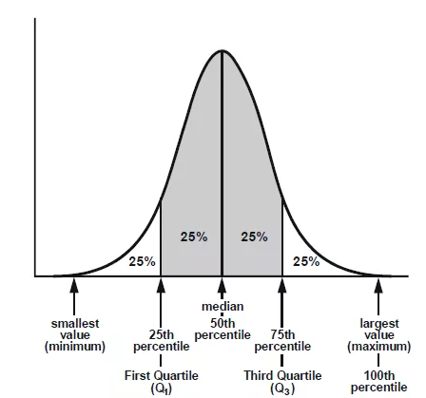






Slide 43
Box and Whisker Diagrams
Looking at the box plot on its own:
Median
UQ
LQ
Maximum value
Minimum value
whisker
whisker

Slide 44
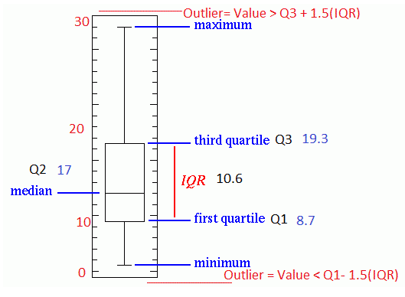
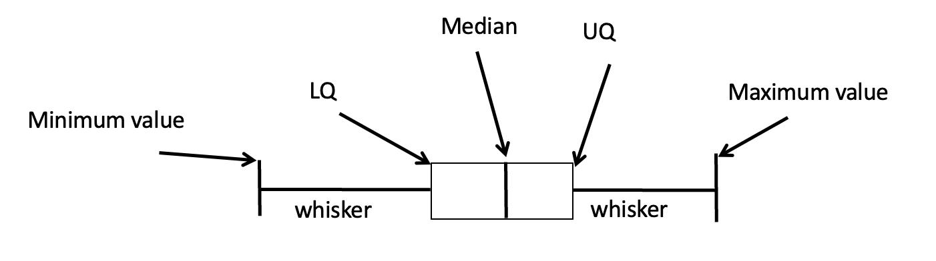

Slide 45
Finding the median, quartiles and inter-quartile range.
Example : Find the median and quartiles for the data below.
6, 3, 9, 8, 4, 10, 8, 4, 15, 8, 10
Order the data
Q₁
Q₂
Q₃
3, 4, 4, 6, 8, 8, 8, 9, 10, 10, 15,
Lower Quartile = 4
Upper Quartile = 10
Median = 8
Inter-Quartile Range = 10 - 4 = 6

Slide 46

Box Plot Analysis
2, 5, 6, 6, 7, 8, 8, 8, 9, 9, 10, 15
Median = 8 hours and the inter-quartile range = 9 – 6 = 3 hours.
The lower inner fence = Q1 – (1.5 * IQR) = 6-(1.5*3) = 6-(4.5) = 1.5
The Upper inner fence = Q3 + (1.5 * IQR) = 9+(1.5*3) = 9 + 4.5 = 13.5

Slide 47
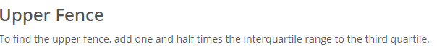

Slide 48
Box and Whisker Diagrams
Median = 8
UQ = 9
LQ = 6
Maximum value = 15
Minimum value = 2
whisker
whisker
IQR

Slide 49
Five number summary
The five number summary takes this form:
Minimum, Q1, Median, Q3, Maximum

Slide 50

Quartiles
Quartiles are values that divide the data in quarters.
The first quartile (Q1) is the value so that 25% of the data values are below it. The third quartile (Q3) is the value so that 75% of the data values are below it. You may have guessed that the second quartile is the same as the median, since the median is the value so that 50% of the data values are below it.
This divides the data into quarters; 25% of the data is between the minimum and Q1, 25% is between Q1 and the median, 25% is between the median and Q3, 25% is between Q3 and the maximum value.

Slide 51
To find the first quartile, we need to find the data value so that 25% of the data is below it. If n is the number of data values, we compute a locator by finding 25% of n. If this locator is a decimal value, we round up, and find the data value in that position. If the locator is a whole number, we find the mean of the data value in that position and the next data value. This is identical to the process we used to find the median, except we use 25% of the data values rather than half the data values as the locator.

Slide 52



Problem -1
Suppose we have measured 9 females, and their heights (in inches) sorted from smallest to largest are:
59 60 62 64 66 67 69 70 72
What are the first and third quartiles?

Slide 53

To find the first quartile we first compute the locator: 25% of 9 is L = 0.25(9) = 2.25. Since this value is not a whole number, we round up to 3. The first quartile will be the third data value: 62 inches.
To find the third quartile, we again compute the locator: 75% of 9 is 0.75(9) = 6.75. Since this value is not a whole number, we round up to 7. The third quartile will be the seventh data value: 69 inches.
For the 9 female sample, the median is 66, the minimum is 59, and the maximum is 72. The 5 number summary is: 59, 62, 66, 69, 72.

Slide 54
Problem - 2
Suppose we had measured 8 females, and their heights (in inches) sorted from smallest to largest are:
59 60 62 64 66 67 69 70
What are the first and third quartiles? What is the 5 number summary?

Slide 55
To find the first quartile we first compute the locator: 25% of 8 is L = 0.25(8) = 2. Since this value is a whole number, we will find the mean of the 2nd and 3rd data values: (60+62)/2 = 61, so the first quartile is 61 inches.
The third quartile is computed similarly, using 75% instead of 25%. L = 0.75(8) = 6. This is a whole number, so we will find the mean of the 6th and 7th data values: (67+69)/2 = 68, so Q3 is 68.
Note that the median could be computed the same way, using 50%.
The 5-number summary combines the first and third quartile with the minimum, median, and maximum values.

Slide 56
For the 8 female sample, the median is 65, the minimum is 59, and the maximum is 70, so the 5 number summary would be: 59, 61, 65, 68, 70.

Slide 57
Box plot
A box plot is a graphical representation of a five-number summary.
To create a box plot, a number line is first drawn. A box is drawn from the first quartile to the third quartile, and a line is drawn through the box at the median. “Whiskers” are extended out to the minimum and maximum values.

Slide 58
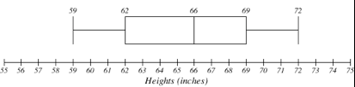
The box plot below is based on the 9 female height data with 5 number summary:
59, 62, 66, 69, 72.

Slide 59
Try it out
The total cost of textbooks for the term was collected from 36 students. Find the 5 number summary of this data.
$140 $160 $160 $165 $180 $220 $235 $240 $250 $260 $280 $285 $285 $285 $290 $300 $300 $305 $310 $310 $315 $315 $320 $320 $330 $340 $345 $350 $355 $360 $360 $380 $395 $420 $460 $460

Slide 60
Returning to the household income data from earlier in the section, create the five-number summary.
Income (thousands of dollars) Frequency
15 6
20 8
25 11
30 17
35 19
40 20
45 12
50 7

Slide 61
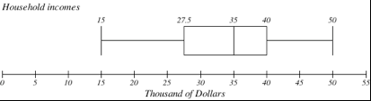
The box plot below is based on the household income data with 5 number summary:
15, 27.5, 35, 40, 50

Slide 62
Data Transformation
Smoothing: remove noise from data
Aggregation: summarization, data cube construction
Generalization: concept hierarchy climbing
Normalization: scaled to fall within a small, specified range
min-max normalization
z-score normalization
normalization by decimal scaling
Attribute/feature construction
New attributes constructed from the given ones

Slide 63
Data Transformation: Normalization
Min-max normalization: to [new_min_{A}, new_max_{A}]
Ex. Let income range $12,000 to $98,000 normalized to [0.0, 1.0]. Then $73,600 is mapped to
Z-score normalization (μ: mean, σ: standard deviation):
Ex. Let μ = 54,000, σ = 16,000. Then
Normalization by decimal scaling
Where j is the smallest integer such that Max(|ν’|) < 1

Slide 64
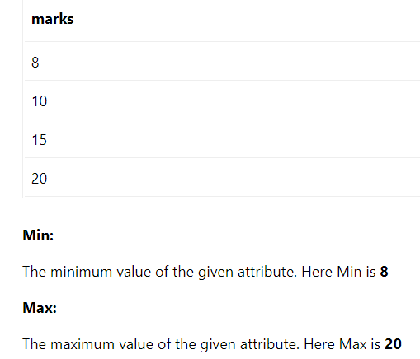

Slide 66
Co-variance and Correlation
Cigs (X ) | Lung Cap (Y )
0 | 45
5 | 42
10 | 33
15 | 31
20 | 29
10 | 36

Slide 67
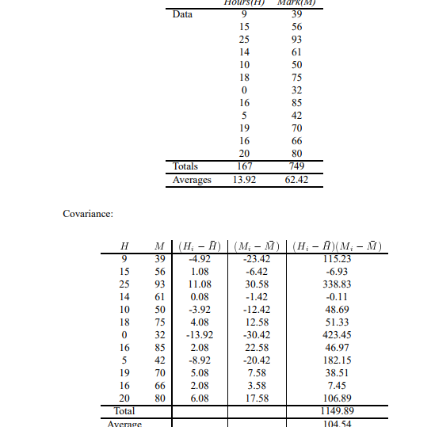

Slide 68
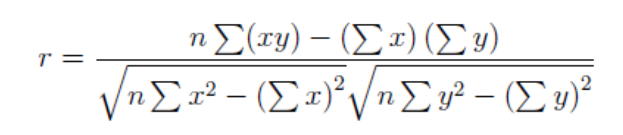

Slide 69
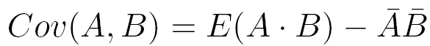
Co-Variance: An Example
It can be simplified in computation as
Suppose two stocks A and B have the following values in one week: (2, 5), (3, 8), (5, 10), (4, 11), (6, 14).
Question: If the stocks are affected by the same industry trends, will their prices rise or fall together?
E(A) = (2 + 3 + 5 + 4 + 6)/ 5 = 20/5 = 4
E(B) = (5 + 8 + 10 + 11 + 14) /5 = 48/5 = 9.6
Cov(A,B) = (2×5+3×8+5×10+4×11+6×14)/5 − 4 × 9.6 = 4
Thus, A and B rise together since Cov(A, B) > 0.

Slide 71
Correlation Analysis
The term correlation refers to the degree of relationship between two or more variables.
If a change in one variable effects a change in the other variable, the
variables are said to be correlated.
There are basically three types of correlation, namely positive
correlation, negative correlation and zero correlation

Slide 72
Is there a relationship between the number of employee training hours and the number of on-the-job accidents?
Is there a relationship between the number of hours a person sleeps
and their reaction time?
Is there a relationship between the number of hours a student
spends studying for a calculus test and the student's score on that calculus test?

Slide 73
Mathematically, the strength and direction of a linear relationship between two variables is represented by the correlation coecient. Suppose that there are n ordered pairs (x, y) that make up a sample from a population. The correlation coefficient r is given by:

Slide 74
This will always be a number between -1 and 1 (inclusive).
If r is close to 1, we say that the variables are positively correlated. This means there is likely a strong linear relationship between the two variables, with a positive slope.
If r is close to -1, we say that the variables are negatively correlated. This means there is likely a strong linear relationship between the two variables, with a negative slope.
If r is close to 0, we say that the variables are not correlated. This means that there is likely no linear relationship between the two variables, however, the variables may still be related in some other way.

Slide 76
Example 1: The time x in years that an employee spent at a company and the employee's hourly pay, y, for 5 employees are listed in the table below. Calculate and interpret the correlation coefficient r. Include a plot of the data.

Slide 78
There is a strong positive correlation between the number of years and
employee has worked and the employee's salary, since r is very close to 1.

Slide 79
Try it out

Slide 80
There is a weak negative correlation between the study time and final exam grade since r is closer to 0 than it is to -1.

Slide 81
Try it out

Slide 83
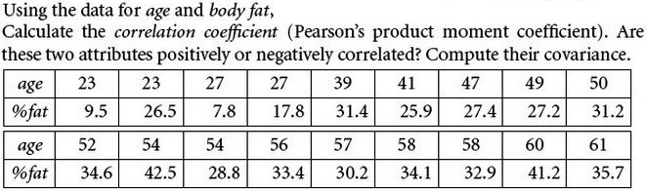
Exercise

Slide 84
Regression using Least Square

Slide 85
Covariance
In an example dataset both the height of all the students in a class, and the mark they received for that paper is presented.
We could then perform statistical analysis to see if the height of a student has any effect on their mark.
Standard deviation and variance only operate on 1 dimension, so that you could only calculate the standard deviation for each dimension of the data set independently of the other dimensions.
However, it is useful to have a similar measure to find out how much the dimensions vary from the mean with respect to each other.
Covariance is such a measure. Covariance is always measured between 2 dimensions.

Slide 86
Covariance
If you calculate the covariance between one dimension and itself, you get the variance. So, if you had a 3-dimensional data set (x,y,z), then you could measure the covariance between the x and y dimensions, the x and z dimensions, and the y and z dimensions. Measuring the covariance between x and x , or y and y , or z and z would give you the variance of the x, y and z dimensions respectively.

Slide 87
More than two attributes: covariance matrix
Contains covariance values between all possible dimensions (=attributes):
Example for three attributes (x,y,z):

Slide 88
PCA
From k original variables: x1,x2,...,xk:
Produce k new variables: y1,y2,...,yk:
y1 = a11x1 + a12x2 + ... + a1kxk
y2 = a21x1 + a22x2 + ... + a2kxk
...
yk = ak1x1 + ak2x2 + ... + akkxk
Such that
yk's are uncorrelated (orthogonal)
y1 explains as much as possible of original variance in data set
y2 explains as much as possible of remaining variance
etc.

Slide 89
PCA Example –STEP 1
Subtract the mean
from each of the data dimensions. All the x values have x subtracted and y values have y subtracted from them. This produces a data set whose mean is zero.
Subtracting the mean makes variance and covariance calculation easier by simplifying their equations. The variance and co-variance values are not affected by the mean value.

Slide 90
PCA Example –STEP 1
http://kybele.psych.cornell.edu/~edelman/Psych-465-Spring-2003/PCA-tutorial.pdf
ZERO MEAN DATA:
x y
.69 .49
-1.31 -1.21
.39 .99
.09 .29
1.29 1.09
.49 .79
.19 -.31
-.81 -.81
-.31 -.31
-.71 -1.01
DATA:
x y
2.5 2.4
0.5 0.7
2.2 2.9
1.9 2.2
3.1 3.0
2.3 2.7
2 1.6
1 1.1
1.5 1.6
1.1 0.9

Slide 91
PCA Example –STEP 2
Calculate the covariance matrix
cov = .616555556 .615444444
.615444444 .716555556
since the non-diagonal elements in this covariance matrix are positive, we should expect that both the x and y variable increase together.

Slide 92
PCA Example –STEP 3
Calculate the eigenvectors and eigenvalues of the covariance matrix
eigenvalues = .0490833989
1.28402771
eigenvectors = -.735178656 -.677873399
.677873399 -.735178656

Slide 93
PCA Example –STEP 4
Reduce dimensionality and form feature vector
the eigenvector with the highest eigenvalue is the principle component of the data set.
Once eigenvectors are found from the covariance matrix, the next step is to order them by eigenvalue, highest to lowest. This gives you the components in order of significance.

Slide 94
PCA Example –STEP 4
Now, if you like, you can decide to ignore the components of lesser significance.
You do lose some information, but if the eigenvalues are small, you don’t lose much
n dimensions in your data
calculate n eigenvectors and eigenvalues
choose only the first p eigenvectors
final data set has only p dimensions.

Slide 95
PCA Example –STEP 4
Feature Vector
FeatureVector = (eig₁ eig₂ eig₃ … eig_{n})
We can either form a feature vector with both of the eigenvectors:
-.677873399 -.735178656
-.735178656 .677873399
or, we can choose to leave out the smaller, less significant component and only have a single column:
- .677873399
- .735178656

Slide 96
PCA Example –STEP 5
Deriving the new data
FinalData = RowFeatureVector x RowZeroMeanData
RowFeatureVector is the matrix with the eigenvectors in the columns transposed so that the eigenvectors are now in the rows, with the most significant eigenvector at the top
RowZeroMeanData is the mean-adjusted data transposed, ie. the data items are in each column, with each row holding a separate dimension.

Slide 97
PCA Example –STEP 5
FinalData transpose: dimensions along columns
x y
-.827970186 -.175115307
1.77758033 .142857227
-.992197494 .384374989
-.274210416 .130417207
-1.67580142 -.209498461
-.912949103 .175282444
.0991094375 -.349824698
1.14457216 .0464172582
.438046137 .0177646297
1.22382056 -.162675287

Slide 98
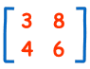
Determinant of 2 x 2 matrix
Determinant =3×6 − 8×4 = 18 − 32 = −14

Slide 99
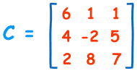
Determinant of 3 x 3 matrix
|C|= 6×(−2×7 − 5×8) − 1×(4×7 − 5×2) + 1×(4×8 − (−2×2))
= 6×(−54) − 1×(18) + 1×(36)
= −306

Slide 100
Principal components - Variance

Slide 101
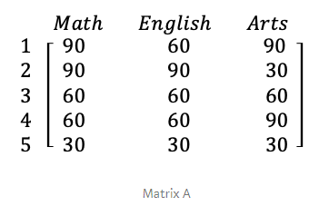
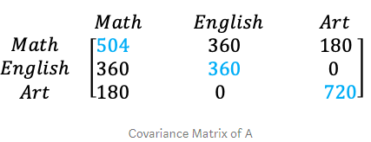
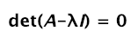
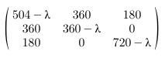
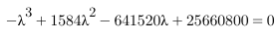
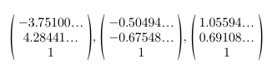
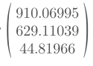
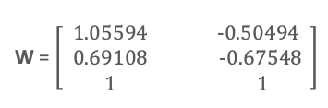
https://towardsdatascience.com/the-mathematics-behind-principal-component-analysis-fff2d7f4b643

Slide 102
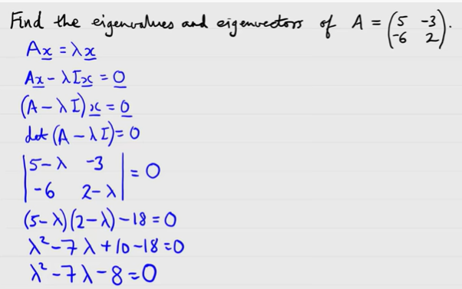

Slide 103
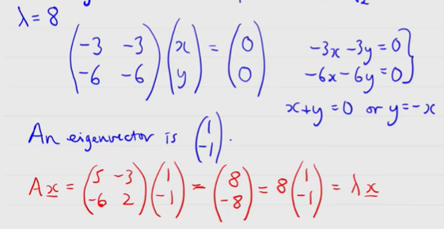

Slide 104
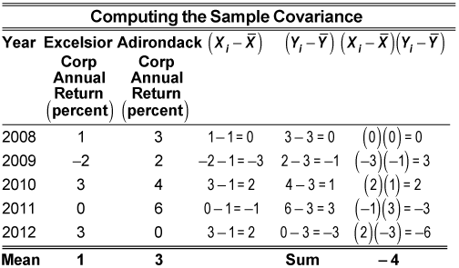

Slide 105
Principal Component Analysis
Principal component analysis(PCA) is one of the techniques for taking high-dimensional data, and using the dependencies between the variables to represent it in a more tractable, lower-dimensional form, without losing too much information. PCA is one of the simplest and most robust ways of doing dimensionality reduction.

Slide 106
We start with p-dimensional vectors, and want to summarize them by projecting down into aq-dimensional subspace.
There are several equivalent ways of deriving the principal components mathematically.
The simplest one is by finding the projections which maximize the variance. The first principal component is the direction in space along which projections have the largest variance

Slide 107
PCA

Slide 108
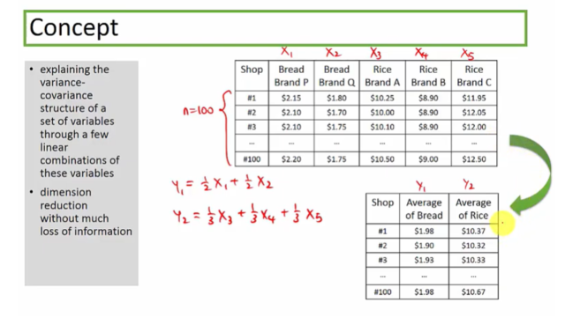

Slide 110
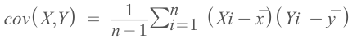
Steps for PCA
Take the whole dataset dxd
Compute the mean of every dimension of the whole dataset
Compute the covariance matrix of the whole dataset
Compute Eigenvectors and corresponding Eigenvalues
Sort the eigenvectors by decreasing eigenvalues and choose k eigenvectors with the largest eigenvalues to form a d × k dimensional matrix W.
Transform the samples onto the new subspace

Slide 111
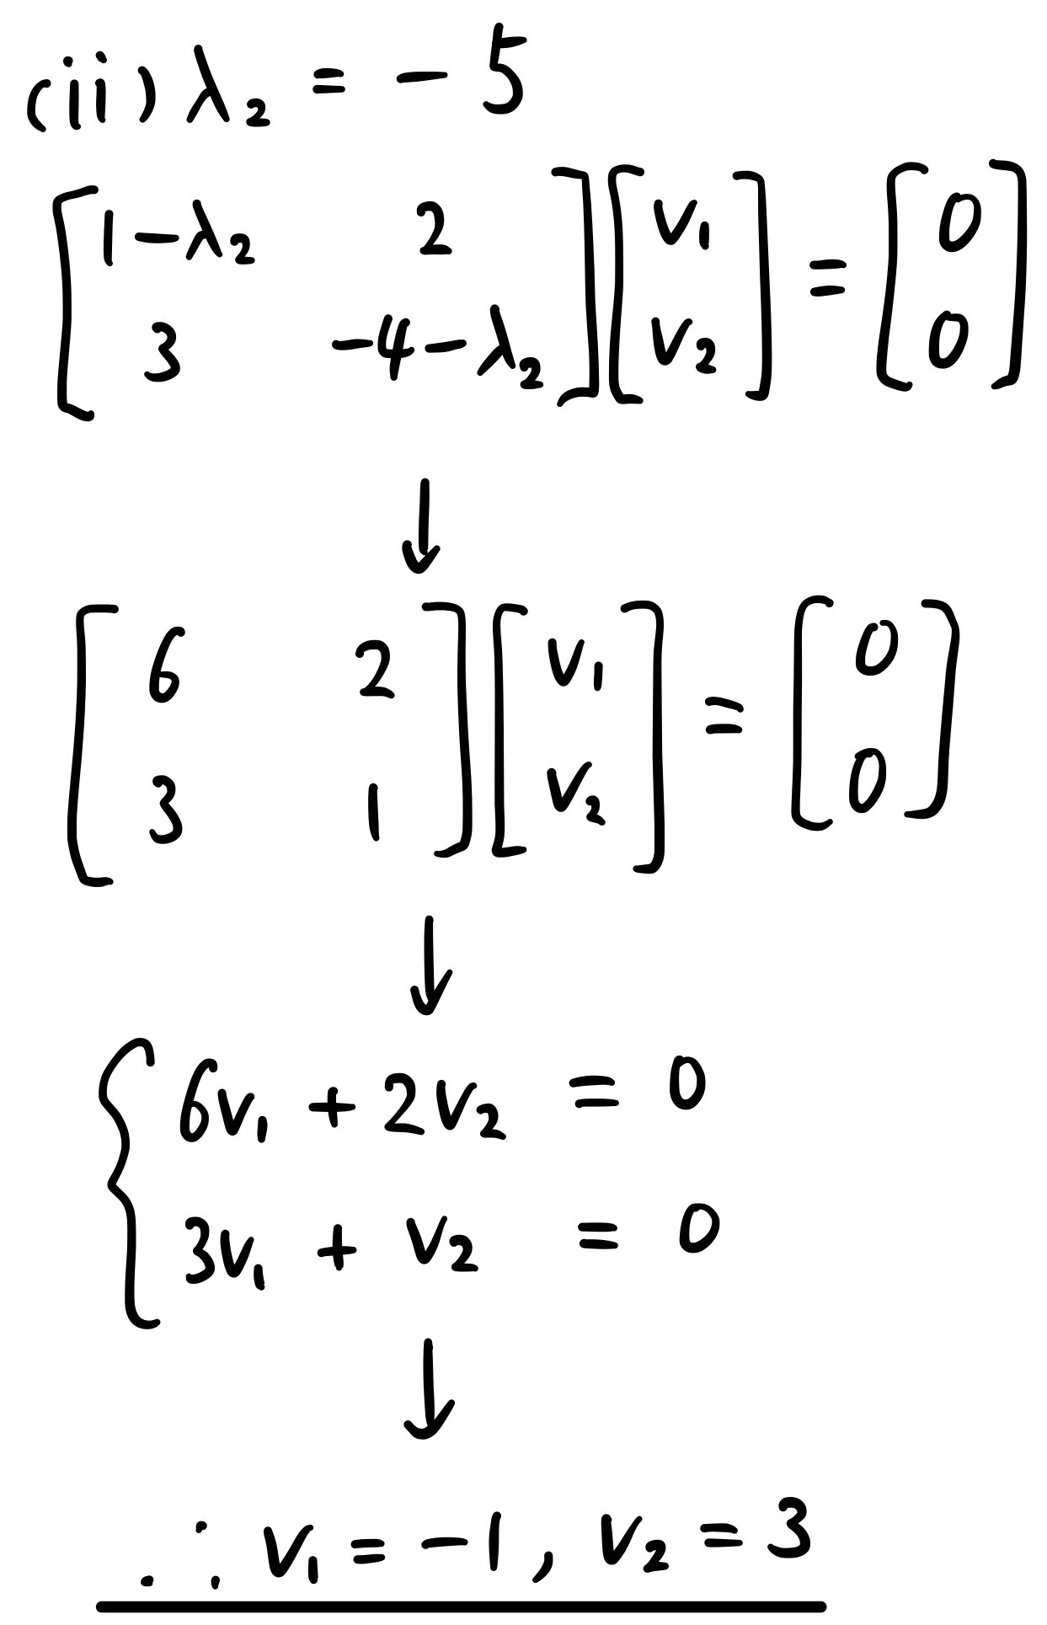

Slide 112
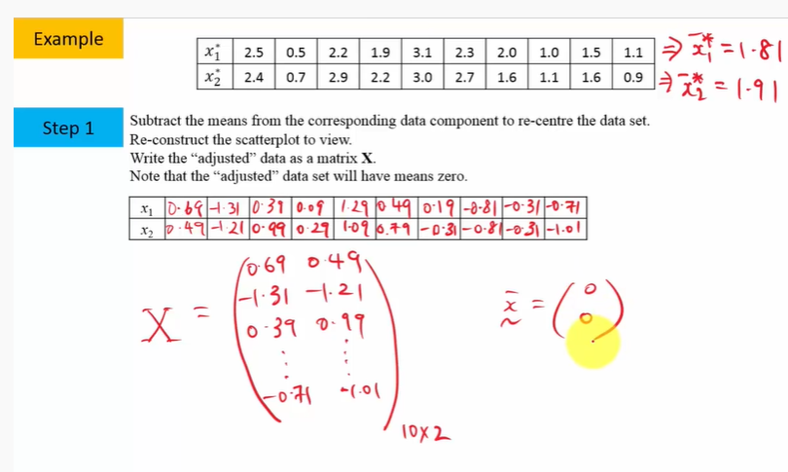

Slide 113
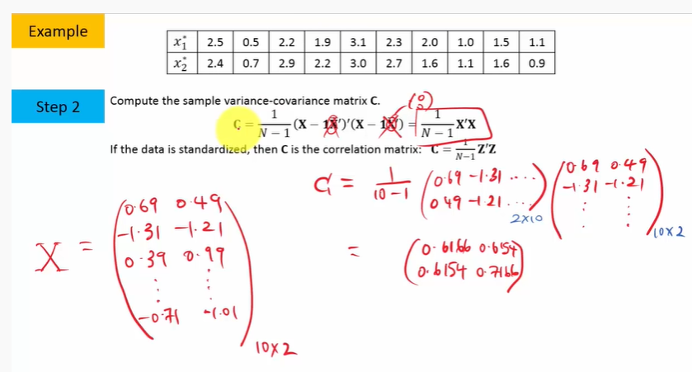

Slide 114
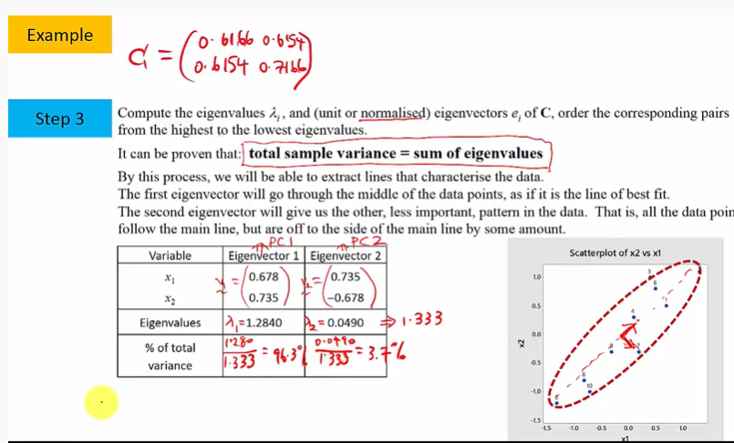

Slide 117
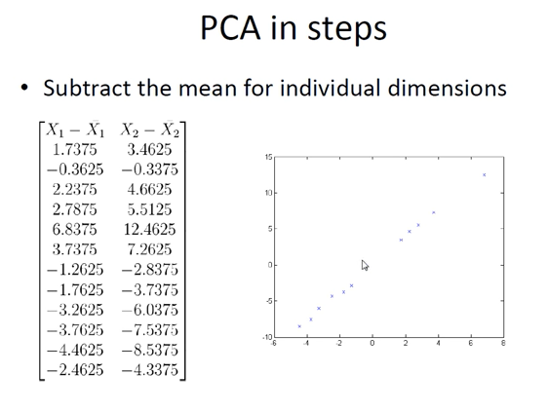

Slide 122
